Slide 1

Improvement of aqueous electrolytes by the addition of polymers
Andreas Grasser, 13.12.2021

Slide 2

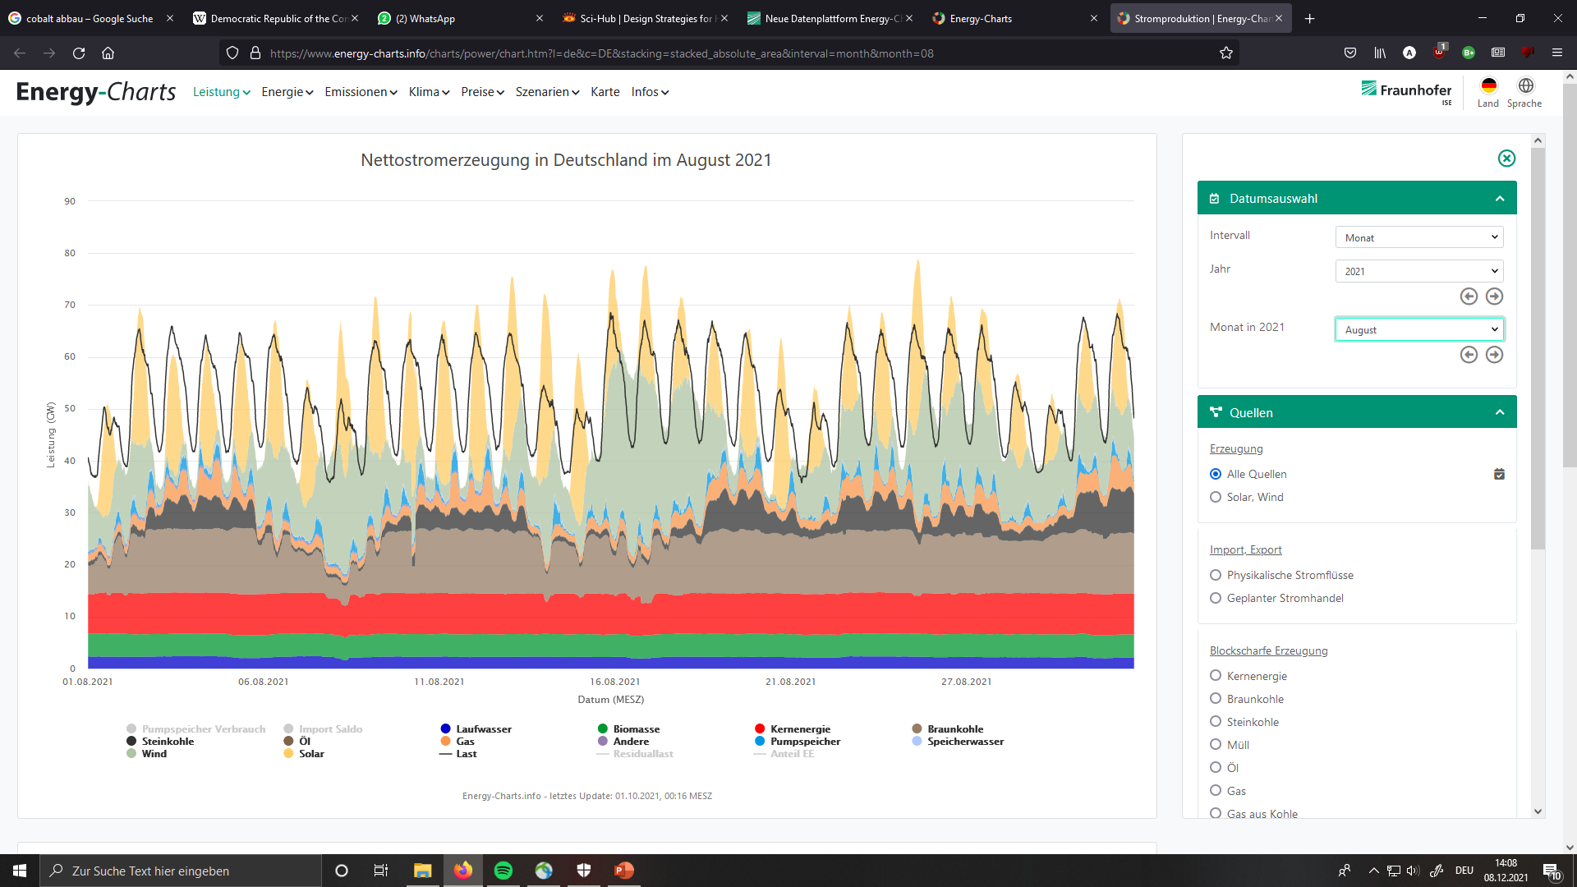
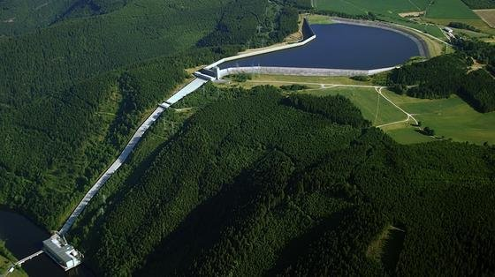
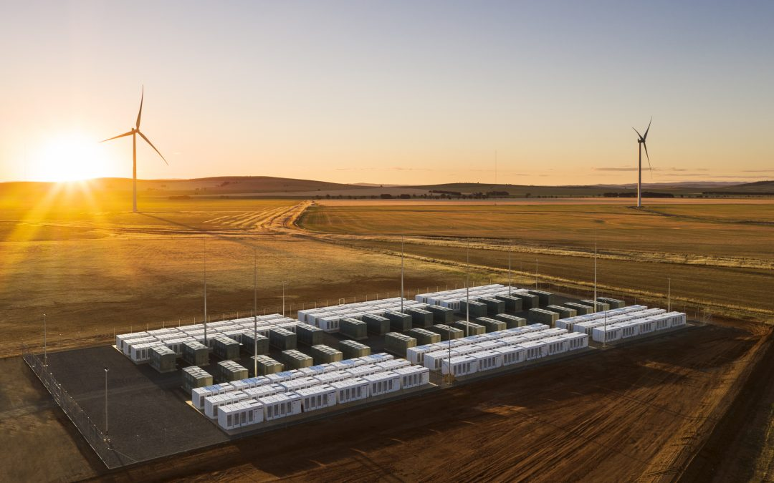
Motivation
Large fluctuations in the production of renewable energy
→ Need for the storage of large amounts of energy
Fraunhofer ISE (energy-charts.info)

Slide 3
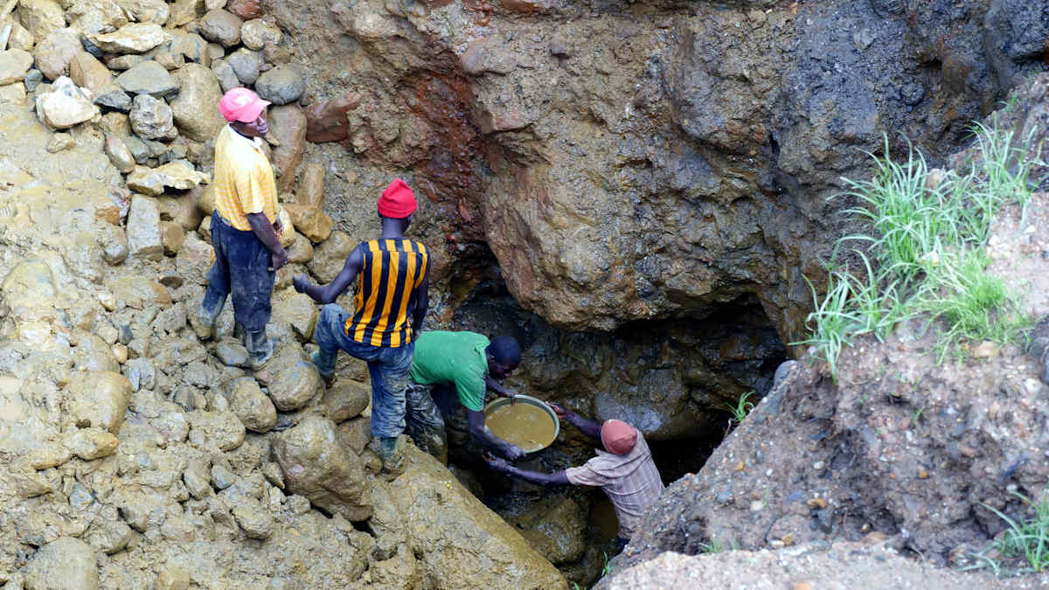

Motivation
Environmental and humanitarian issues of traditional Li-Ion batteries
Dangerous, flammable organic electrolytes
For stationary applications energy density is no big problem
Sodium-ion batteries
Cobalt Mine in the Congo

Slide 4
Motivation
Electrodes | Electrolyte
Cheap | Cheap
Environmentally friendly | Safe
Good stability | Large stability window
… | …
+ current collectors

Slide 5
Electrode

Slide 6
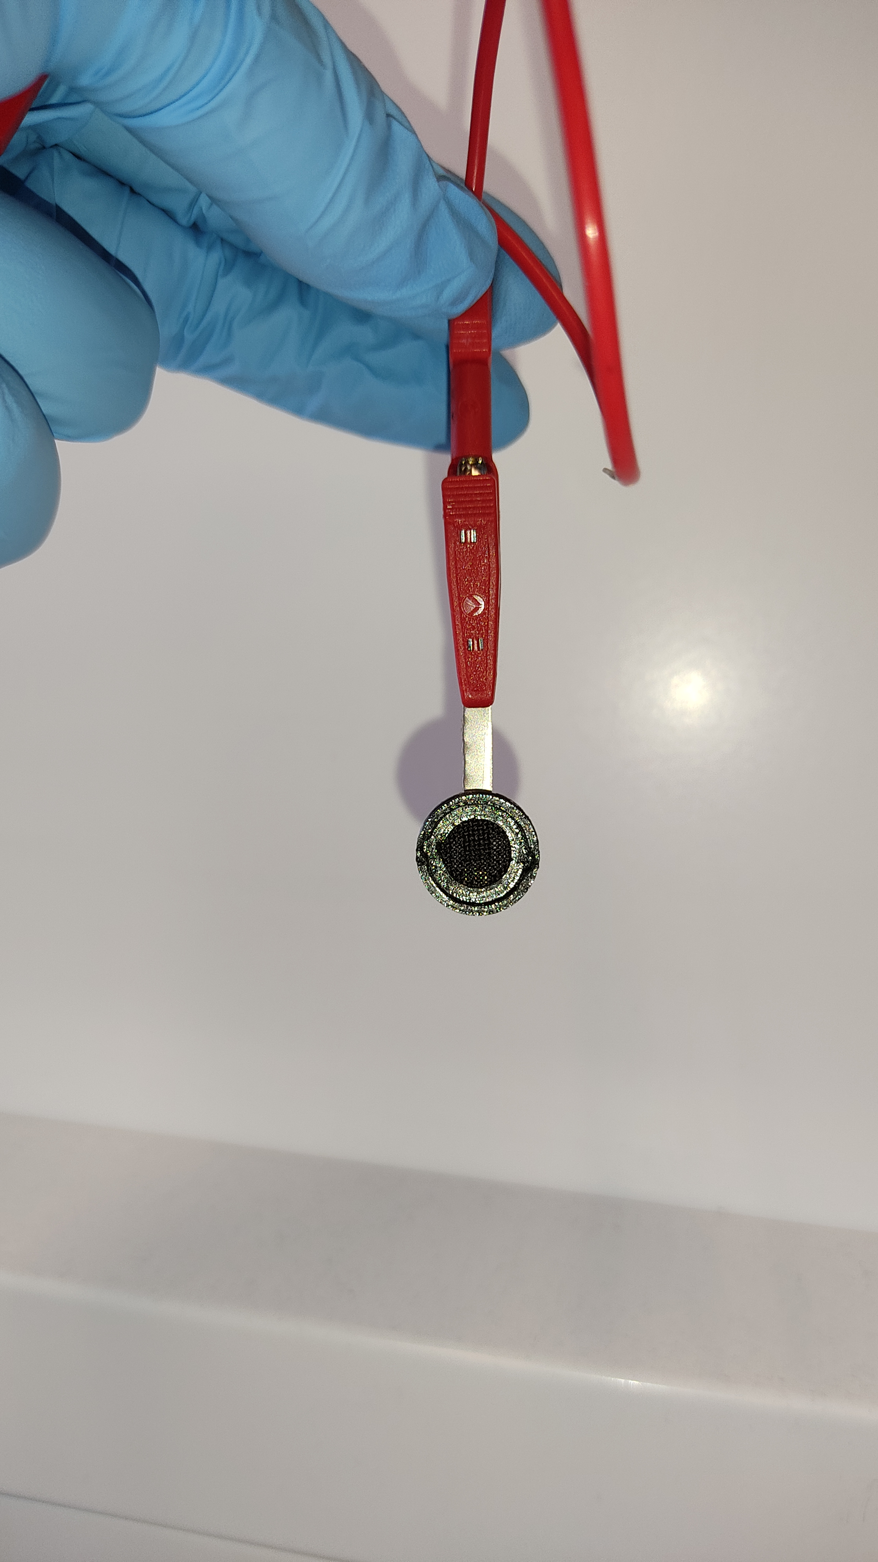
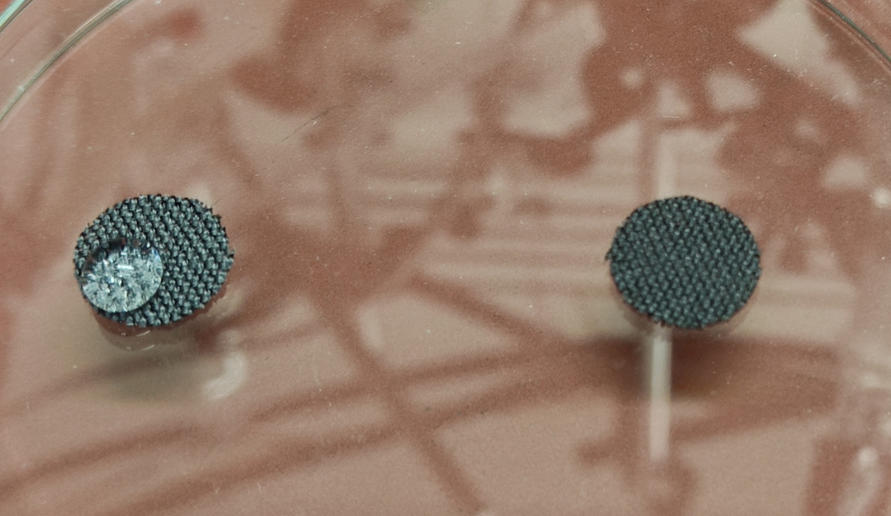
Carbon Cloth Current Collectors
Flexible carbon-based current collector
Normally hydrophobic
After 2M H₂NO₃ treatment: hydrophilic
3D-printed holder with titanium contact
untreated
after treatment

Slide 7
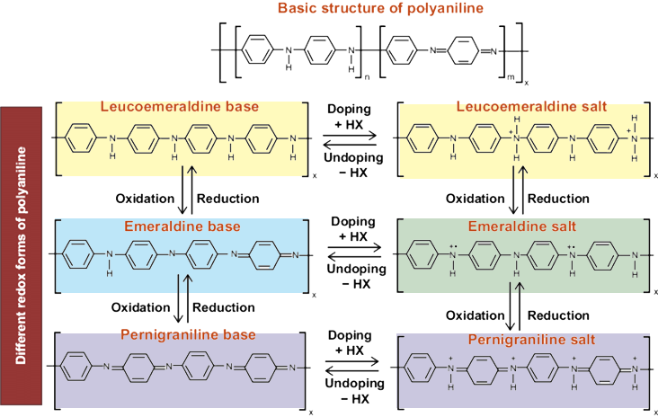
Polyaniline as Electrode Material
Cheap polymer
Environmentally friendly
Charge storage through adsorption
Emeraldine salt conductive → conductive coatings
Two redox peaks

Slide 8
Polyaniline as Electrode Material
Cheap
Environmentally friendly
Safe
Two wide redox peaks
Changes color with oxidation state
Low stability due to volume change at (dis-)charge

Slide 9
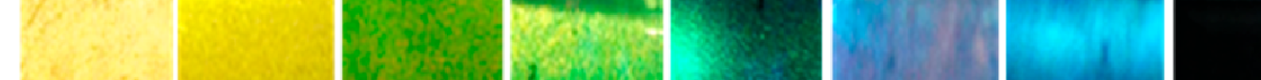
Polyaniline as Electrode Material
Cheap polymer
Environmentally friendly
2 redox peaks
Better peak separation and higher capacity in HCl acid → Due to H⁺ adsorption or due to PANI salt state?
Vs. Ag/AgCl

Slide 10
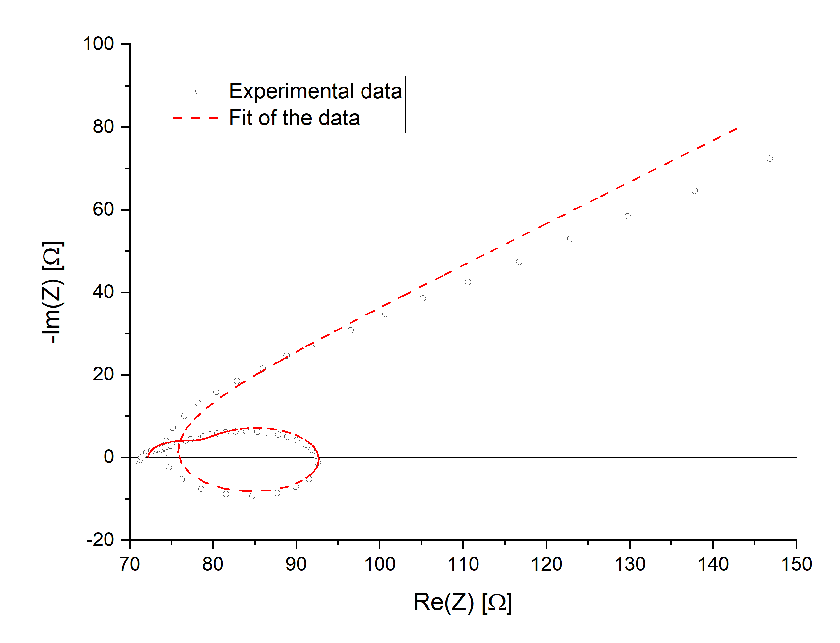
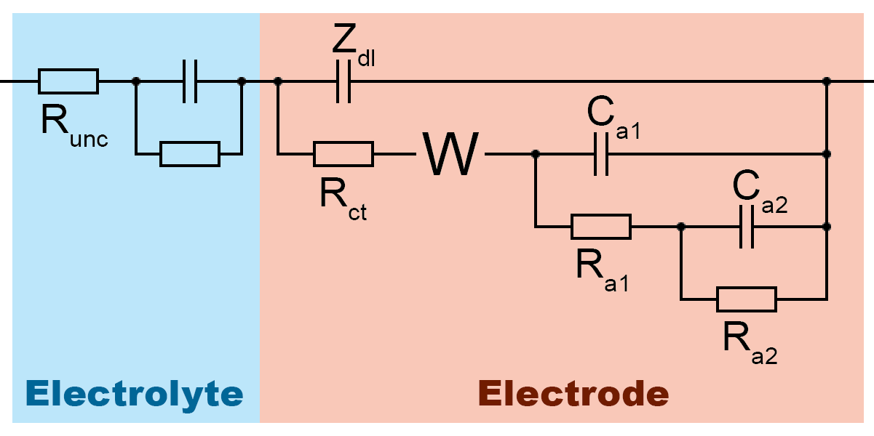
Polyaniline as Electrode Material

Slide 11
Electrolyte

Slide 12
Stability Window of the Electrolyte
Aqueous electrolytes have a relatively low stability window

Slide 13
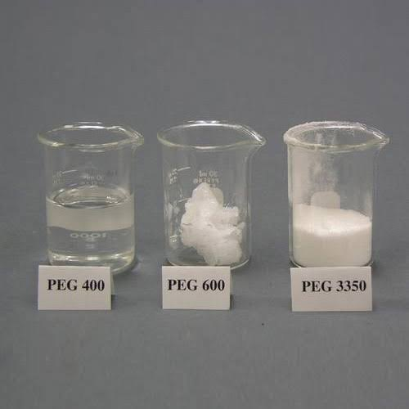
Polyethylen Glycole (PEG)
Polymer
Available with different molar mass

Slide 14
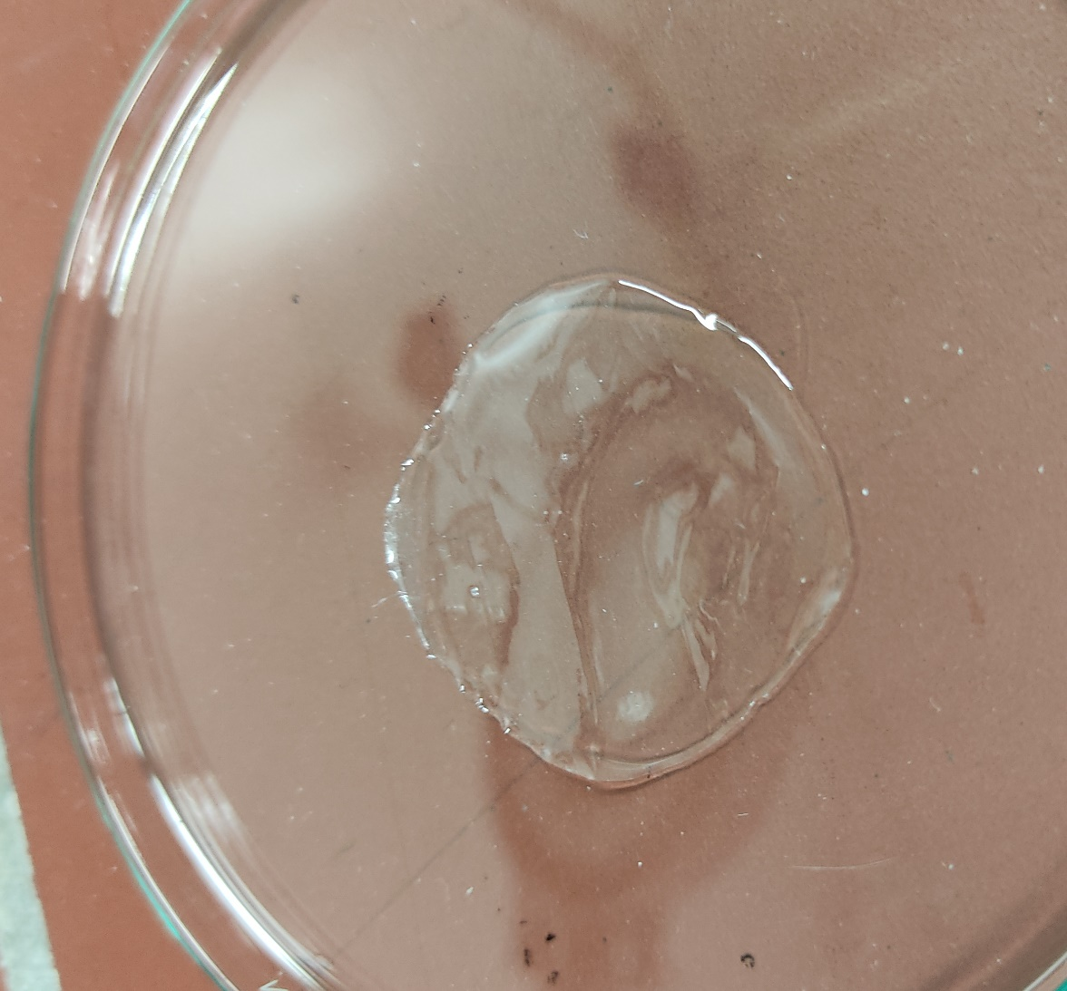
Solid State (Polymer) Electrolytes
e.g. Polyvinyl Alcohol (PVA)
+ also acts as a separator
- poor conductivity

Slide 15

Water Based Electrolytes
Concentrated aqueous electrolyte
Mixed organic-aqueous electrolytes
Hydrate melt
Gel Electrolyte

Slide 16
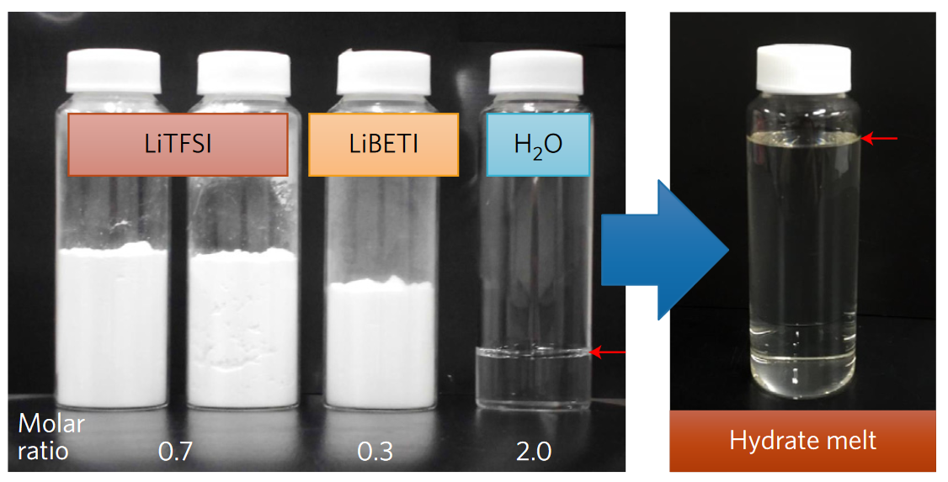
Water Based Electrolytes
Concentrated aqueous electrolyte
Mixed organic-aqueous electrolytes
Hydrate melt
Gel Electrolyte
Yamada, Y., Usui, K., Sodeyama, K. et al. Hydrate-melt electrolytes for high-energy-density aqueous batteries.

Slide 17
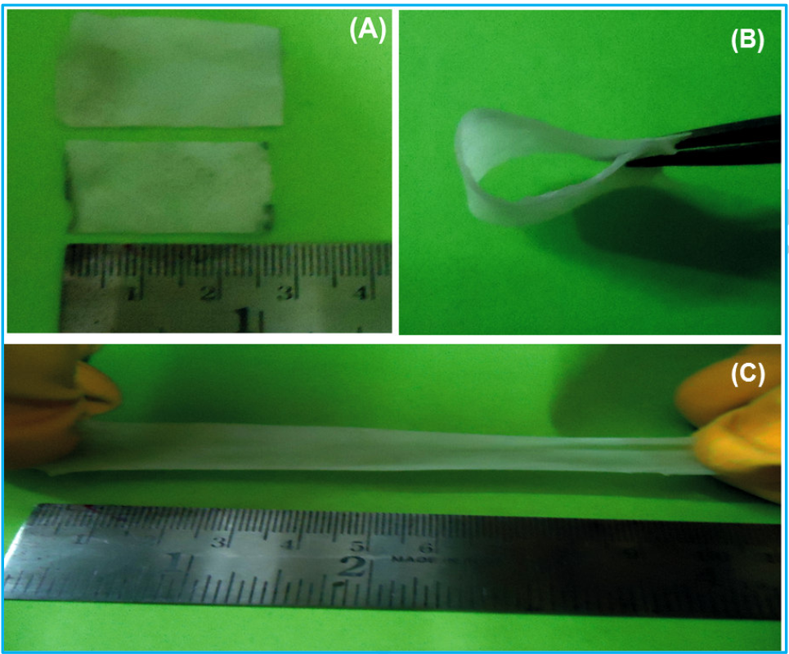
Water Based Electrolytes
Concentrated aqueous electrolyte
Mixed organic-aqueous electrolytes
Hydrate melt
Gel Electrolyte
N.R. Chodankar, D.P. Dubal,A.C. Lokhande, C.D. Lokhande,
Ionically Conducting PVA-LiClO4 Gel Electrolyte for High PerformanceFlexible Solid State Supercapacitors

Slide 18
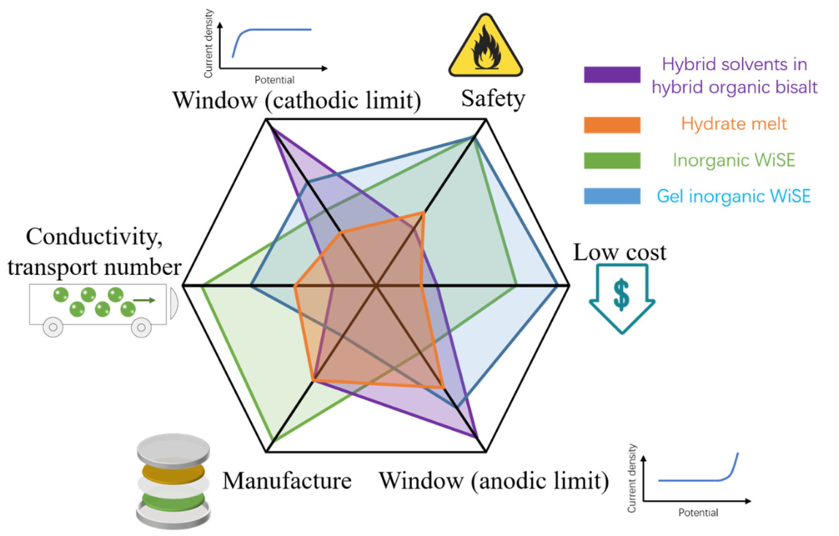
Water Based Electrolytes
Gel electrolytes are good candidates for cheap and safe batteries

Slide 19
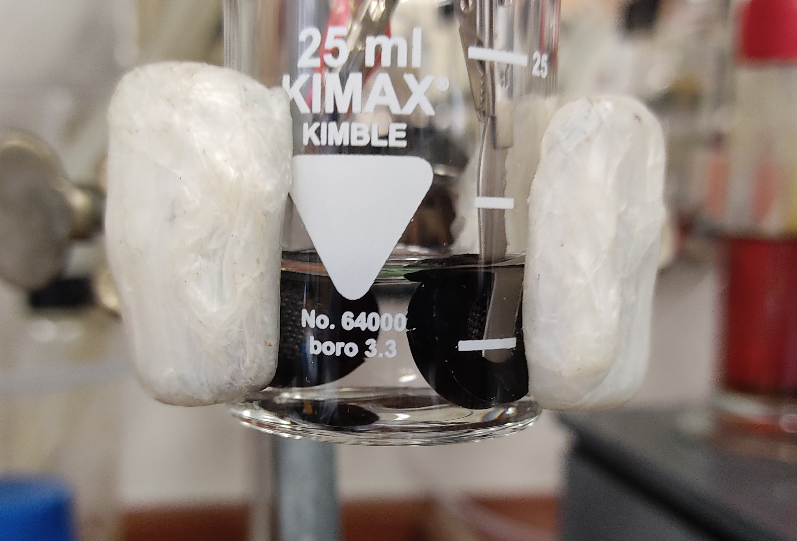
Gel Electrolyte using PVA
Good solubility in water
Cheap
Environmentally friendly

Slide 20
Problem of Carbon Cloth Surface Oxides
Full CV over the whole stability window not possible due to surface oxides
Two half CVs over several cycles

Slide 21
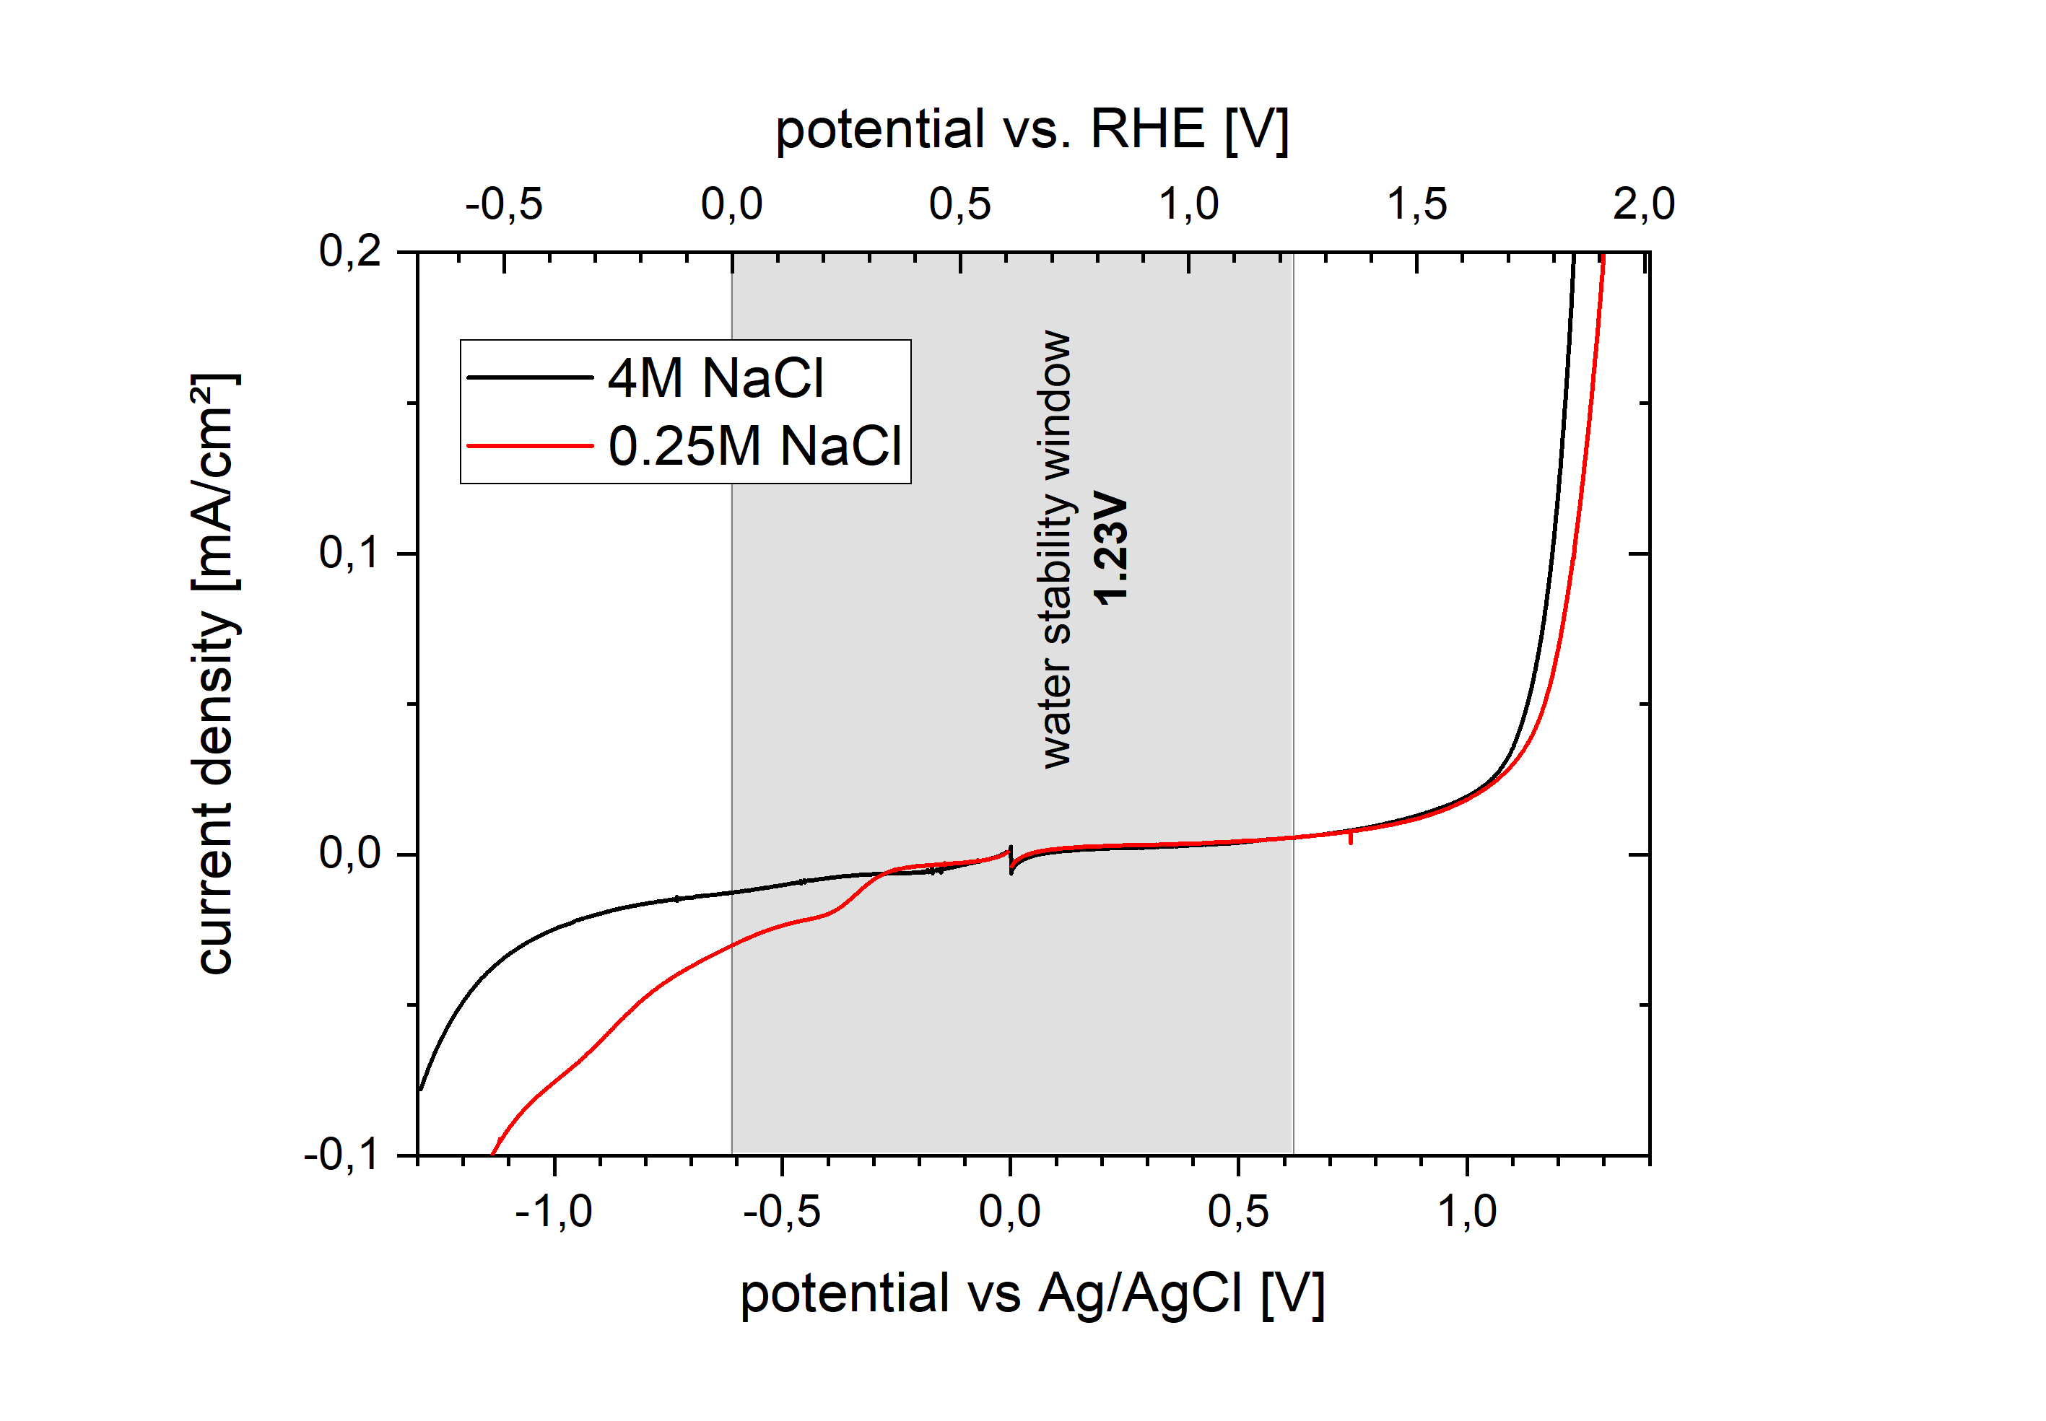
Problem of Carbon Cloth Surface Oxides
.

Slide 22
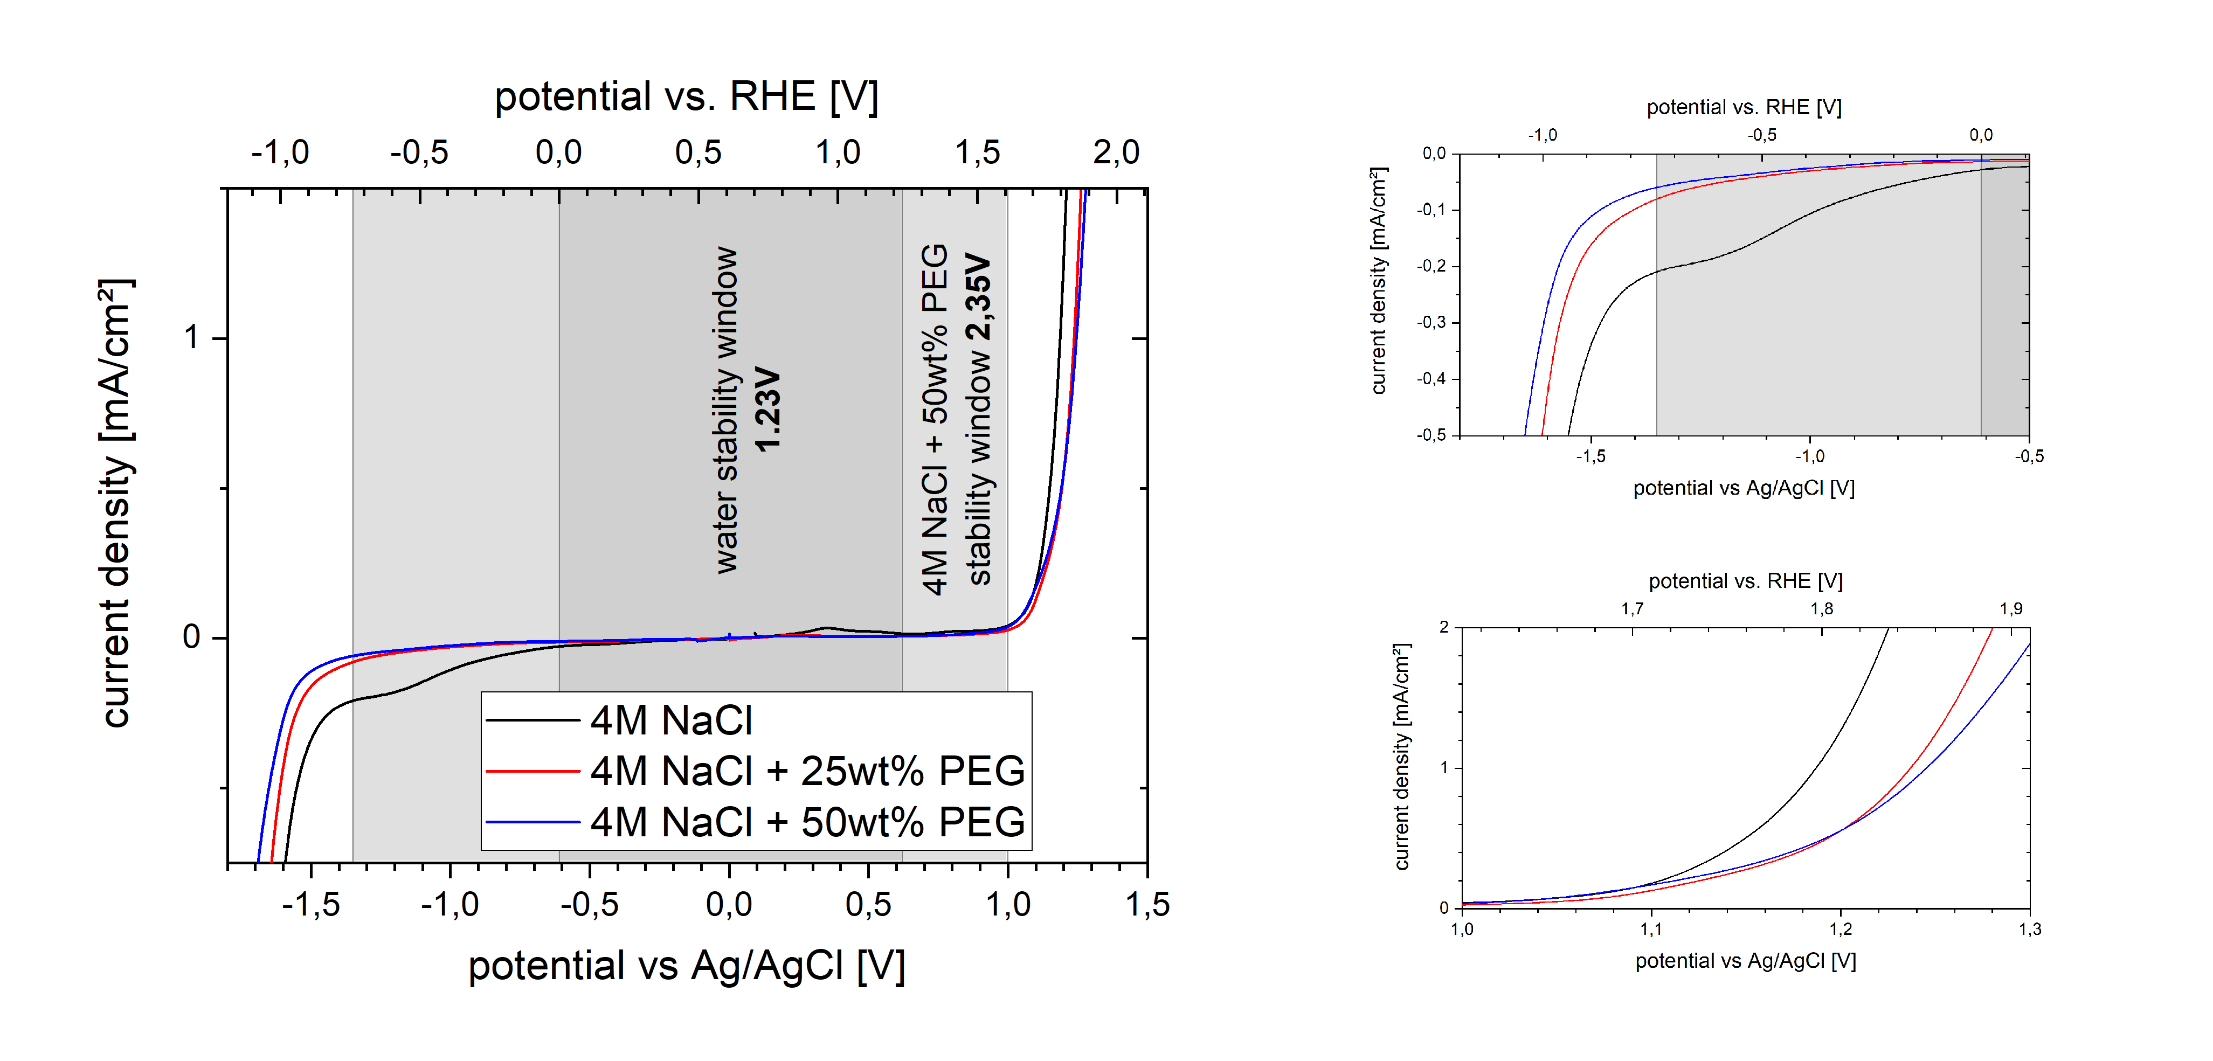
Improvement of stability window with PEG

Slide 23
Gel Electrolyte using PVA
With low concentrations of PVA no larger stability window visible

Slide 24
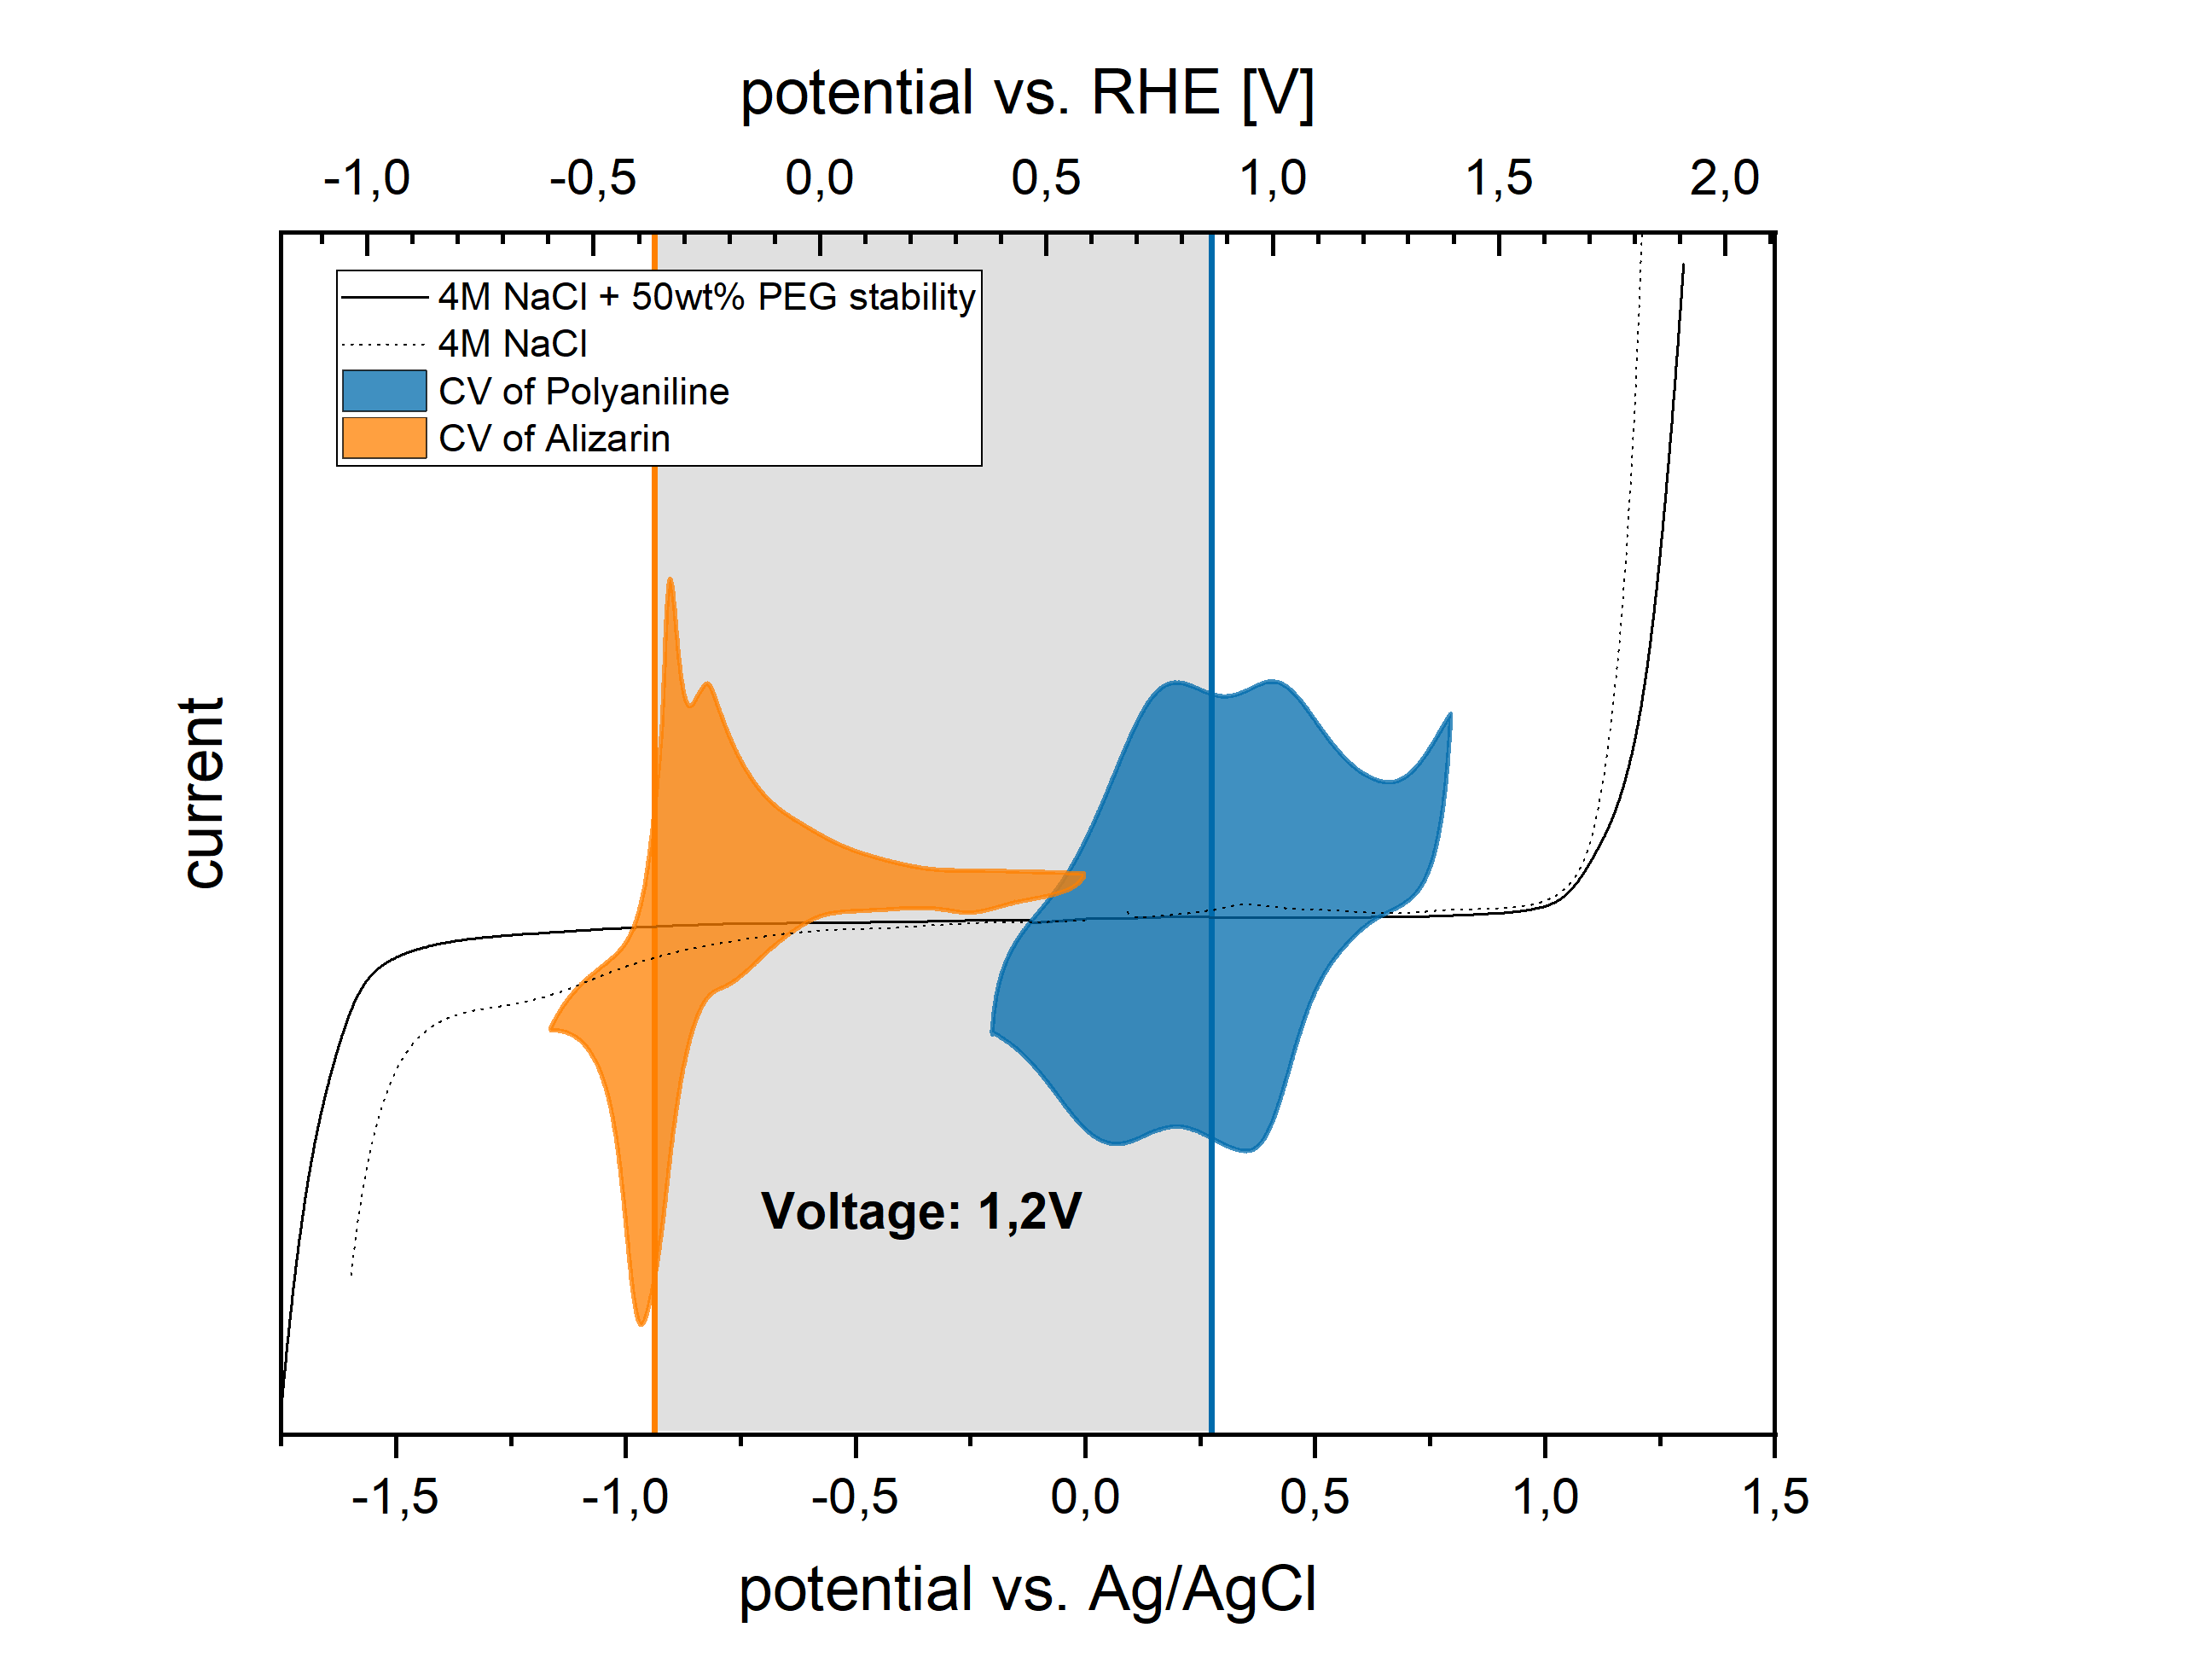
Full cell with alizarin
New electrolyte allows

Slide 25
Further Plans and Current Problems
For gel electrolyte: no Ag/AgCl-reference electrode possible
Oversized (NiHCF) counter electrode?
Compare different ways of PANI coating:
Electropolymerisation of aniline (thin films)
Slurry mixing (larger mass loading)

